Slide 1


Davide De Carlo
08 June 2023

Slide 2

Outline
Executive Summary
Introduction
Methodology
Results
Conclusion
Appendix/Additional insights

Slide 3
Executive Summary
Summary of methodologies
Data collected through SpaceX API and web-scraping
Data prepared and transformed into a useable subset
EDA with data visualization
EDA with SQL
Building an interactive map with Folium
Building a Dashboard with Plotly Dash
Predictive analysis (Classification)
Conclusion
Summary of all results
EDA identified the best features to predict successful landings;
Machine Learning model predicted if the Falcon 9 first stage will land successfully.

Slide 4
Introduction
Project background and context
In this project, the goal is to predict if the Falcon 9 first stage will land successfully. The context revolves around predicting the success of Falcon 9 first stage landings, which is crucial in determining the cost of a launch. SpaceX, offering launches at a significantly lower cost compared to other providers, achieves these savings through the reuse of the first stage. Consequently, understanding the determinants of successful landings can be valuable for companies competing with SpaceX in bidding for rocket launches.
Problems you want to find answers
What factors influence the successful landing of a rocket?
How do different relationships with specific rocket variables impact the success rate of a landing?
What conditions must SpaceX fulfill to optimize rocket success rates?
Can we develop a model capable of predicting landing success to accurately calculate launch costs?
Which launch site(s) offer the best performance in terms of successful landings?

Slide 5

Section 1

Slide 6
Methodology
Executive Summary
Data collection methodology:
SpaceX Rest API
Web-scraping of Falcon 9 Wikipedia page
Perform data wrangling
incorporated a landing outcome label derived from outcome data, followed by the summarization and analysis of features
Perform exploratory data analysis (EDA) using visualization and SQL
Perform interactive visual analytics using Folium and Plotly Dash
Perform predictive analysis using classification models
Data were normalized, divided into training and test data sets, and evaluated by four different classification models, the accuracy of each model was assessed.

Slide 7
Data Collection
We collected data sets from SpaceX API and, via web scraping techniques from the Falcon9 Wikipedia page.
To gather launch-related information, we utilized the API once again by querying the launch IDs. Specifically, we focused on extracting data from the following columns: rocket, payloads, launchpad, and cores.
From the rocket data, we obtained details such as the name of the booster.
By analyzing the payload data, we obtained insights into the payload's mass and the intended orbit.
The launchpad data provided us with valuable information, including the name of the launch site, as well as its longitude and latitude coordinates.
Through examining the cores data, we gained knowledge about the landing outcome, the type of landing, the number of flights associated with a specific core, the usage of grid fins, reusability status of the core, and other relevant details.

Slide 8
Data Collection – SpaceX API
Data is collected from SpaceX REST API which are about launch and landing specifications, rocket usage.
Data was further enriched via SpaceX API calls with additional API data
Rocket
Launchpad
Payload Mass
Orbit
Collecting the data GitHub URL
Request rocket launch data via SpaceX API
Decode response and convert to a dataframe using .json_normalize()
Get launches from SpaceX API using custom functions
Create dictionary from the data
Create and filter dataframe from the dictionary
Replace missing values of Payload Mass with calculated .mean()
Export data to csv file

Slide 9
Data Collection - Scraping
Web scraping performed from the Wikipedia page to collect Falcon 9 historical launch records.
Web Scraping [GitHub]
Request data (Falcon 9 launch data) from Wikipedia
Create BeautifulSoup object from HTML response
Extract column names from HTML
Parsing HTML tables
Create dictionary from the data
Create dataframe from the dictionary
Export data to csv file

Slide 10
Data Wrangling
Loaded previously acquired data into a data frame.
Converted mission outcome text values into a fixed "Class" category (0 for fail, 1 for success) and added a new column.
Processed data using Pandas:
Calculated the number of launches for each site.
Determined the number and occurrence of different orbits.
Replaced missing data in critical columns with the average of existing data.
The processed data is now prepared for further analysis.
Data Wrangling [github]
Loaded data into a data frame
Converted mission outcome into a fixed "Class" category
Processed data using Pandas

Slide 11
EDA with Data Visualization
Scatter Charts
Flight Number vs. Launch Site: Identify successful launch sites and observe trends over time.
Payload vs. Launch Site: Determine launch site requirements based on payload weight.
Flight Number vs. Orbit Type: Analyze mission outcome by orbit type over time.
Payload vs. Orbit Type: Investigate if payload weight influences optimal orbit.
Bar Chart:
Orbit vs. Success Rate: Determine which orbits have higher success rates.
Line Chart:
Launch Success Trend: Track the yearly trend of average success rates.
EDA with Data Visualization [github]

Slide 12
EDA with SQL
List:
• Date of first successful landing on ground pad
• Names of boosters which had success landing on drone ship and have payload mass greater than 4,000 but less than 6,000
• Total number of successful and failed missions
• Names of booster versions which have carried the max payload
• Failed landing outcomes on drone ship, their booster version and launch site for the months in the year 2015
• Count of landing outcomes between 2010-06-04 and 2017-03-20 (desc)
EDA with SQL [github]
Display:
• Names of unique launch sites
• 5 records where launch site begins with ‘CCA’
• Total payload mass carried by boosters launched by NASA (CRS)
• Average payload mass carried by booster version F9 v1.1.

Slide 13
Build an Interactive Map with Folium
Markers Indicating Launch Sites:
Placed a blue circle at the coordinate of NASA Johnson Space Center, displaying its name as a popup label using latitude and longitude coordinates.
Added red circles at the coordinates of all launch sites, showing their names as popup labels using latitude and longitude coordinates.
Map with Folium:
Created an interactive map using Folium library.
Colored Markers of Launch Outcomes:
Represented successful launches with green markers and unsuccessful launches with red markers at each launch site.
This color coding helps visualize the launch sites with high success rates.
Distances Between a Launch Site and Proximities:
Incorporated colored lines to demonstrate the distance between the launch site CCAFS SLC40 and its proximity to the nearest coastline, railway, highway, and city. These lines provide visual context regarding the location of the launch site and its surroundings.
Build an Interactive Map with Folium [github]

Slide 14
Build a Dashboard with Plotly Dash
Launch Site Dropdown: Enables users to select either all launch sites or a specific launch site for analysis.
Payload Mass Range Slider: Allows users to define the range of payload masses to consider in the analysis.
Pie Chart: Success Rates. Provides a visual representation of successful and unsuccessful launches as a percentage of the total, based on the selected launch site or all sites.
Scatter Chart: Payload Mass vs. Success Rate by Booster Version
Presents a scatter chart that demonstrates the correlation between payload mass and launch success, categorized by booster version.

Slide 15
Build a Dashboard with Plotly Dash
The dashboard facilitates efficient analysis of the relationship between payload characteristics and launch sites, enabling the identification of optimal launch sites based on payload mass.
Build a Dashboard with Plotly Dash [github]

Slide 16
Predictive Analysis (Classification)
Data Preparation
Convert the "Class" column into a NumPy array.
Standardize the data using StandardScaler by fitting and transforming the data.
Split the data into training and testing sets using train_test_split.
Utilize GridSearchCV for parameter optimization, with a cross-validation value (cv) of 10.
Apply GridSearchCV on various algorithms: Logistic Regression (LogisticRegression()), Support Vector Machine (SVC()), Decision Tree (DecisionTreeClassifier()), and K-Nearest Neighbors (KNeighborsClassifier()).
Calculate the accuracy of all models on the test data using the .score() function.
Assess the confusion matrix for each model.
Determine the best model based on evaluation metrics: Jaccard Score, F1 Score, and Accuracy.
Model Selection and Optimization
Evaluation and Comparison
Predictive Analysis (Classification) [github]

Slide 17
Results
Exploratory Data Analysis:
Launch success rates have shown improvement over time.
KSC LC-39A stands out with the highest success rate among landing sites.
Orbits ES-L1, GEO, HEO, and SSO have achieved a perfect success rate of 100%.
Visual Analytics:
Most launch sites are situated near the equator and in close proximity to coastal areas.
The launch sites are strategically located far enough from potentially vulnerable targets such as cities, highways, and railways.
The sites remain accessible for logistical support, facilitating the transportation of personnel and materials.

Slide 18
Results
Predictive Analytics:
Based on the dataset, the Decision Tree model has demonstrated superior predictive capabilities.
Key Findings from Exploratory Data Analysis:
SpaceX utilizes four launch sites.
The average payload for the F9 v1.1 booster is 2,928 kg.
Falcon 9 booster versions exhibited successful landings on drone ships for payloads above the average.
Two booster versions, F9 v1.1 B1012 and F9 v1.1 B1015, experienced failures when attempting landings on drone ships in 2015.
The number of successful landing outcomes has increased progressively each year.

Slide 19

Section 2

Slide 20
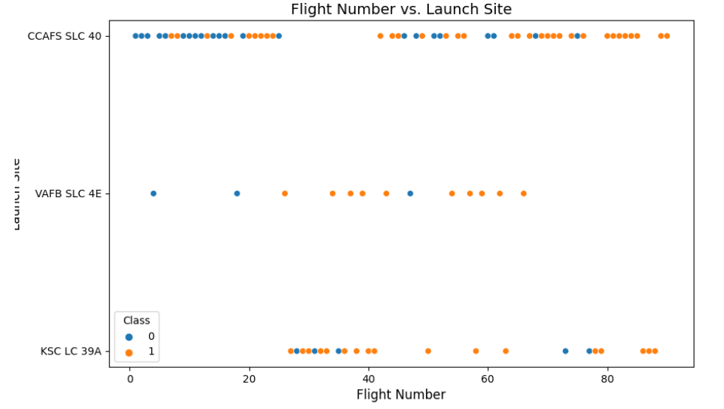
Flight Number vs. Launch Site
Earlier flights had a lower success rate (blue = fail)
Later flights had a higher success rate (orange = success)
Around half of launches were from CCAFS SLC 40 launch site
VAFB SLC 4E and KSC LC 39A have higher success rates
New launches have a higher success rate

Slide 21
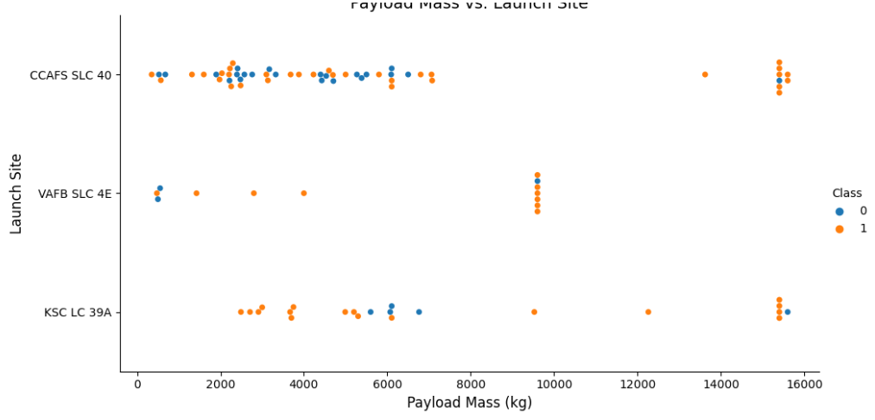
Payload vs. Launch Site
Higher payloads (over 12,000kg) have a better success rate at CCAFS SLC 40 and KSC LC 39A launch sites
KSC LC 39A has a 100% success rate for launches < 5,500 kg
VAFB SKC 4E has not launched anything >10,000 kg

Slide 22
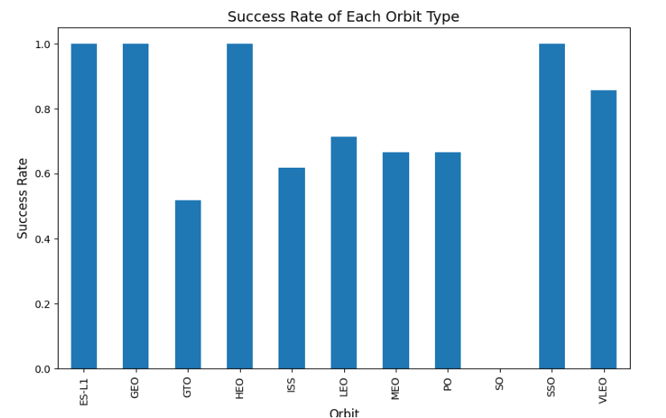
Success Rate vs. Orbit Type
100% Success Rate:
ES-L1, GEO, HEO and SSO
50%-80% Success Rate:
GTO, ISS, LEO, MEO, PO
0% Success Rate:
SO

Slide 23
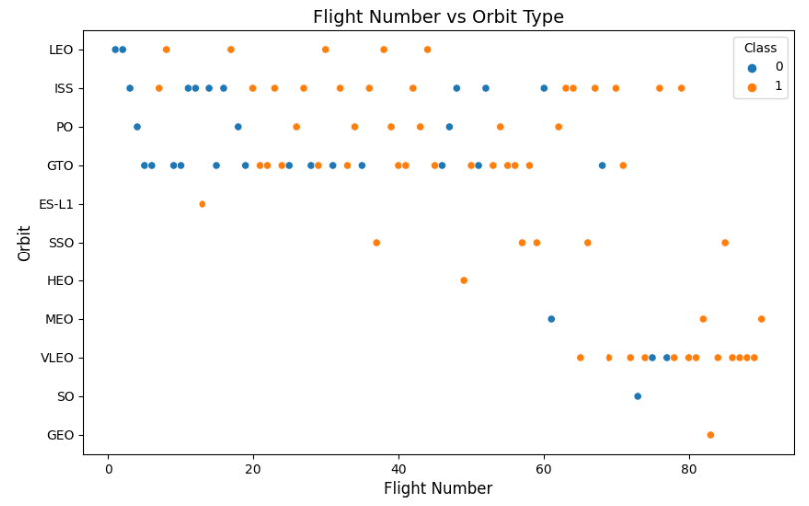
Flight Number vs. Orbit Type
The success rate typically increases with the number of flights for each orbit

Slide 24
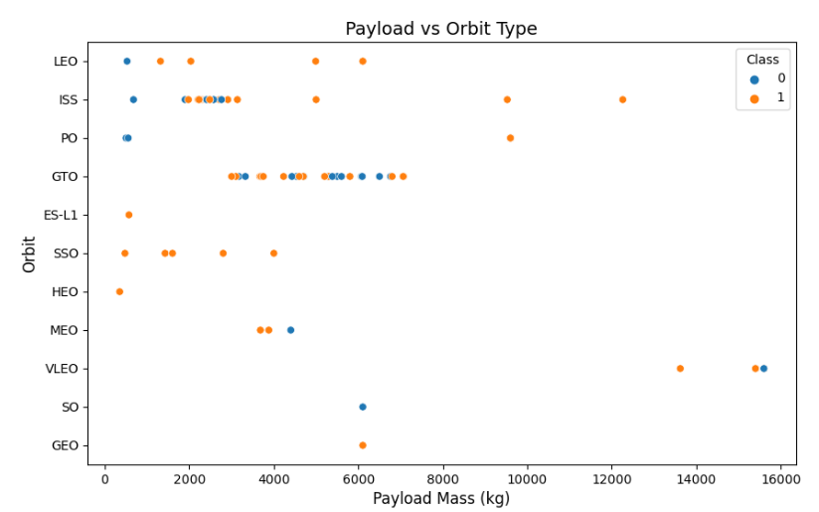
Payload vs. Orbit Type
Heavy payloads are better with LEO, ISS and PO orbits

Slide 25
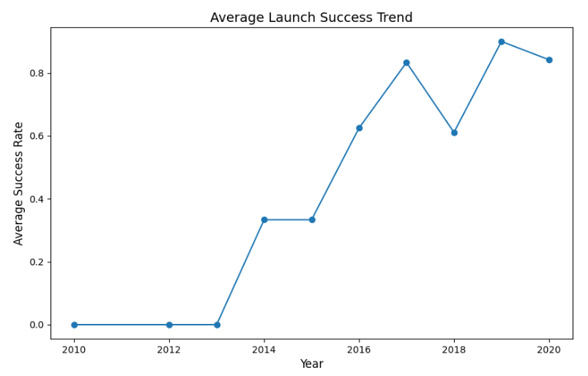
Launch Success Yearly Trend
Overall, the success rate has improved since 2013

Slide 26
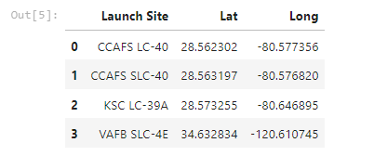
All Launch Site Names
There are 4 launch sites, which can be optained by selecting unique occurrencies of “launch_site” values from the dataset.

Slide 27
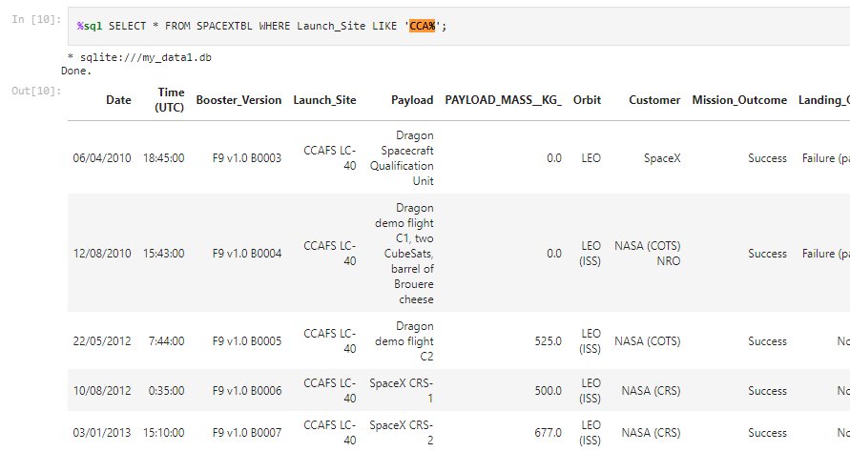
Launch Site Names Begin with 'CCA'
We can identify the first outcomes for all CCA launch sites.

Slide 28
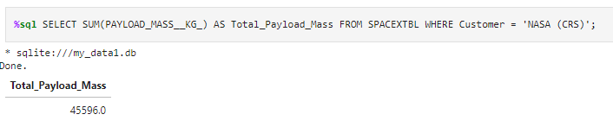
Total Payload Mass
45,596 kg total carried by boosters launched by NASA (CRS)

Slide 29
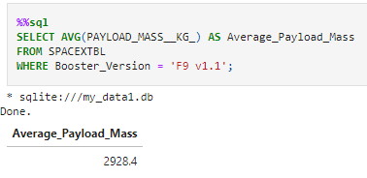
Average Payload Mass by F9 v1.1
2,928 kg (average) carried by booster version F9 v1.1

Slide 30
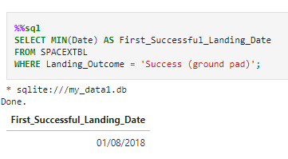
First Successful Ground Landing Date
01/08/2018

Slide 31
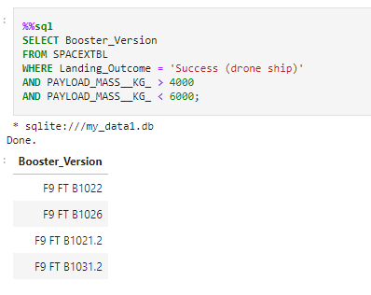
Successful Drone Ship Landing with Payload between 4000 and 6000
Booster mass greater than 4,000 but less than 6,000: F9 FT B1022, F9 FT B1026, F9 FT B1021.2, F9 FT B1031.2

Slide 32
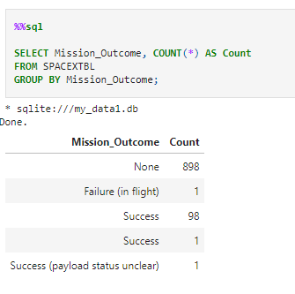
Total Number of Successful and Failure Mission Outcomes
1 Failure in Flight
99 Success
1 Success (payload status unclear)

Slide 33
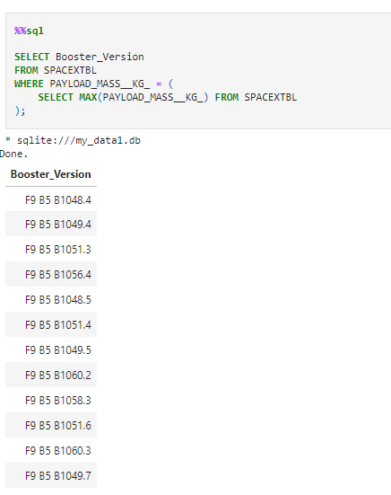
Boosters Carried Maximum Payload
F9 B5 B1048.4
F9 B5 B1049.4
F9 B5 B1051.3
F9 B5 B1056.4
F9 B5 B1048.5
F9 B5 B1051.4
F9 B5 B1049.5
F9 B5 B1060.2
F9 B5 B1058.3
F9 B5 B1051.6
F9 B5 B1060.3
F9 B5 B1049.7

Slide 34
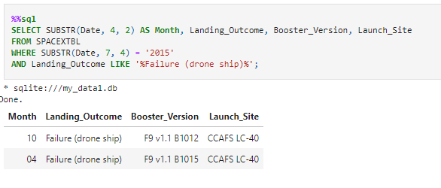
2015 Launch Records
Records which will display the month names, failure landing_outcomes in drone ship ,booster versions, launch_site for the months in year 2015.

Slide 35
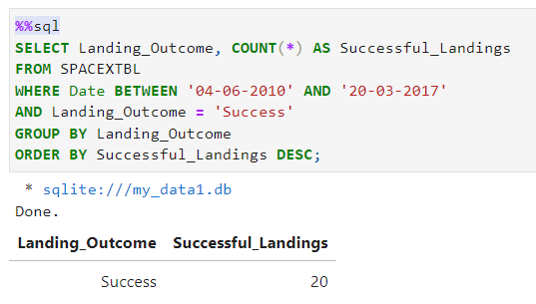
Rank Landing Outcomes Between 2010-06-04 and 2017-03-20
Count of successful landing outcomes between the date 04-06-2010 and 20-03-2017

Slide 36

Section 3

Slide 37
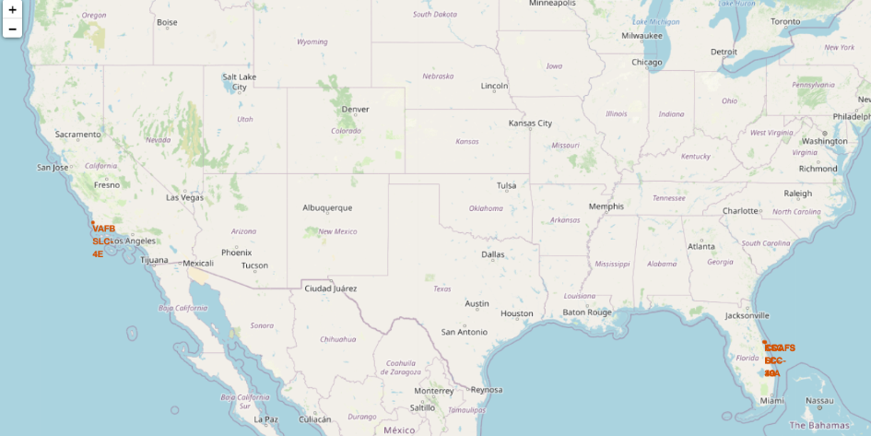
Launch Sites
Proximity to the equator benefits launches to equatorial orbit by leveraging Earth's rotation for a prograde trajectory. Launching from near the equator provides a natural advantage, reducing the need for additional fuel and boosters.

Slide 38
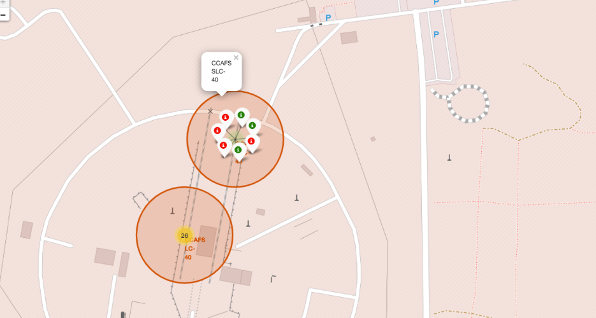
Launch Outcomes
Example of CCAFS SLC-40 which has a 3/7 success rate (42.9%)
Green markers for successful launches
Red markers for unsuccessful launches

Slide 39
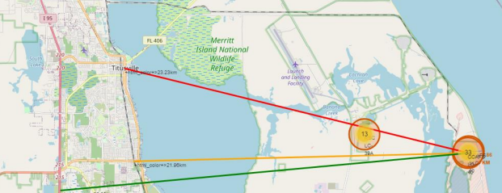
Distance to Proximities
CCAFS SLC-40
City Distance 23.234752126023245
Railway Distance 21.961465676043673
Highway Distance 26.88038569681492
Coastline Distance 0.8627671182499878

Slide 40

Section 4

Slide 41
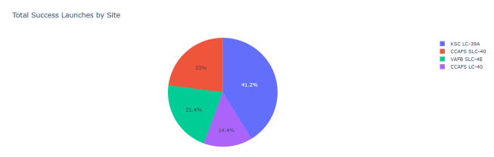
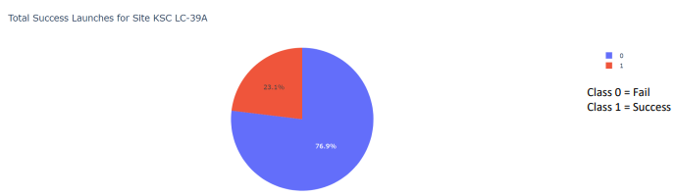
Launch Success by Site
KSC LC-39A is the most successful launch site (41.2%) with the highest success rate score.

Slide 42
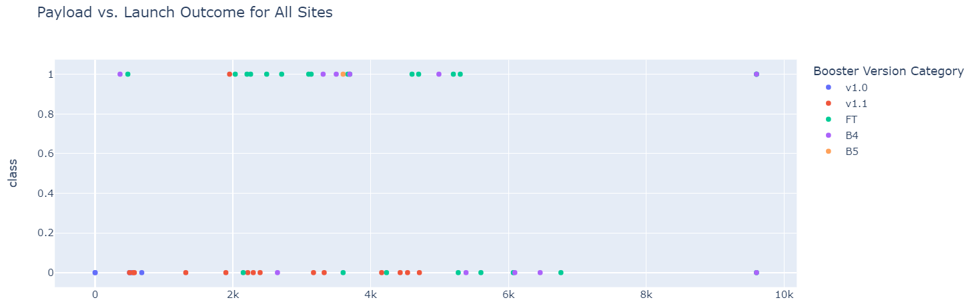
Payload vs Launch Outcome
Payloads between 2,000 kg and 5,000 kg have the highest success rate

Slide 43

Section 5

Slide 44
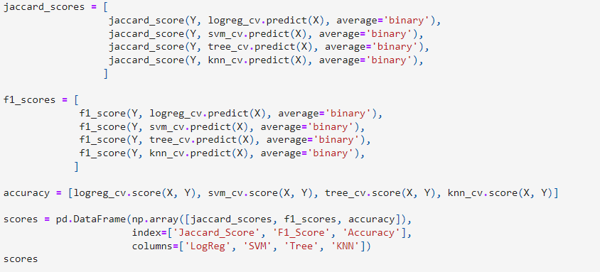
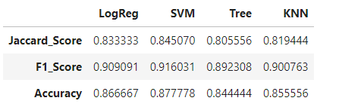
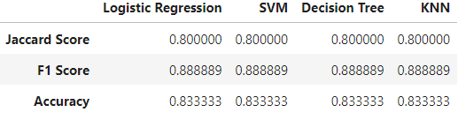
Classification Accuracy
The accuracy is extremely close, this is likely due to the small dataset.

Slide 45
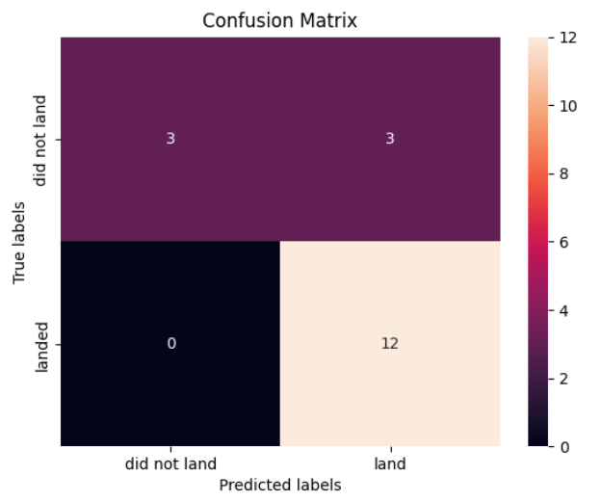
Confusion Matrix
All the confusion matrices were identical
There are 3 false positive, which is not a good news.

Slide 46
Conclusions
Model Performance: the models exhibited similar performance on the test set, with the decision tree model slightly outperforming the others. It can be employed to predict successful landings, ultimately contributing to increased profits.
Key Findings:
Equator Proximity: Most launch sites are strategically located near the equator, leveraging the rotational speed of the Earth to save on fuel and boosters.
Coastal Proximity: All launch sites are situated in close proximity to coastlines.
Launch Success: The overall launch success rate has shown a positive trend over time.
KSC LC-39A: This launch site demonstrated the highest success rate among all sites, particularly for launches with payloads weighing less than 5,500 kg.
Orbit Success: Orbits including ES-L1, GEO, HEO, and SSO achieved a 100% success rate.
Payload Mass: Across all launch sites, there is a positive correlation between higher payload mass (kg) and higher success rates.

Slide 47
Conclusions and additional insights
Additional Insights:
Lower weighted payloads tend to exhibit better success rates compared to heavier payloads.
The success rates of SpaceX launches increase proportionally with the passage of time, indicating a progressive improvement in launch performance.
The Decision Tree Classifier can be employed to predict successful landings, ultimately contributing to increased profits.
A larger dataset will help build on the predictive analytics results to help understand if the findings can be generalizable to a larger data set

Slide 48


